Slide 1
Amazon Electronics Sales Analysis
A Business Intelligence Project

Slide 2
Business Problem Definition

Slide 3
Understanding Product Performance & Customer Behaviour
Our analysis focuses on understanding how different electronics products perform on Amazon, with the goal of improving inventory and pricing decisions. The electronics market is currently crowded, especially with accessories such as cables and adapters, and we want to determine what products truly drive customer interest and how pricing affects customer satisfaction.

Slide 4
Dataset Overview
Our dataset consisted of Amazon electronic products listings.
The key fields we focused on were category, price, rating, reviews.
It was cleaned for consistency & numeric accuracy with missing values handled and numeric fields standardized.
Using the Amazon Sales dataset, our team generated several visualizations to highlight the most essential patterns in product categories, customer engagement, pricing, and ratings that include:

Slide 5
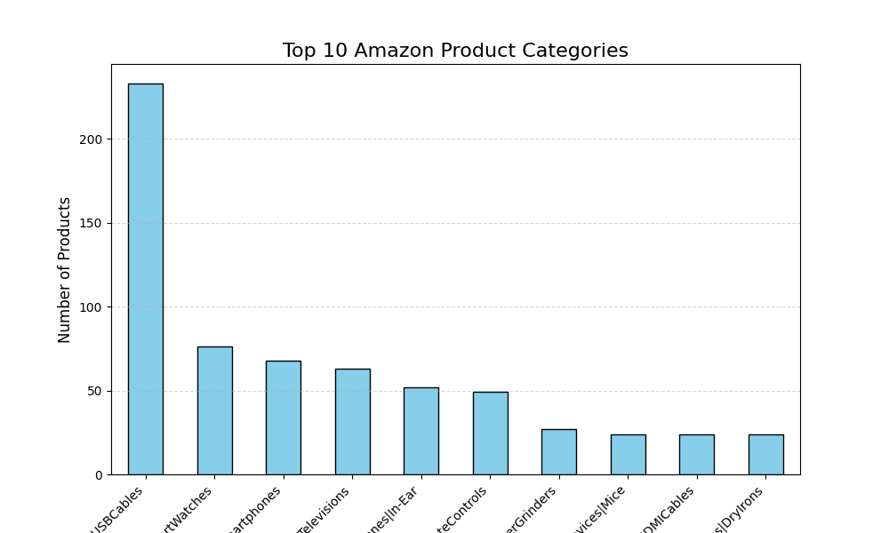
1. Category Dominance
USB Cables appear most frequently in the dataset, dominating the market.
Their presence is nearly three times that of the next leading category.

Slide 6
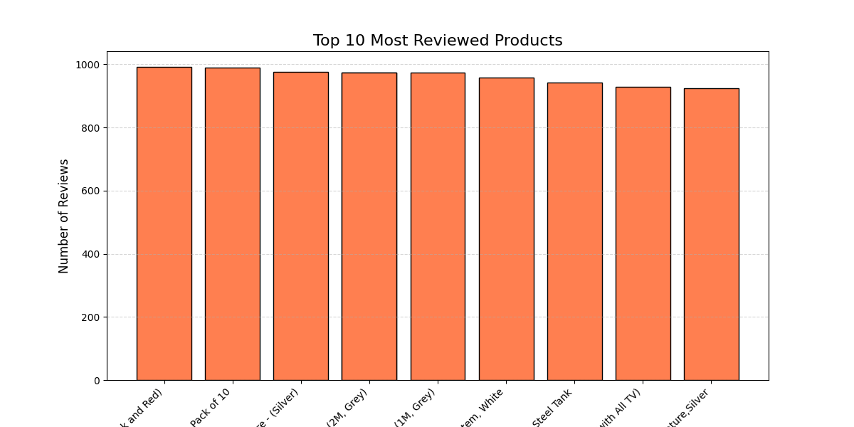
2. Customer Interaction
Products with the highest number of reviews are mostly low-cost accessories.
Items such as Micro USB and HDMI cables consistently attract high customer engagement.

Slide 7
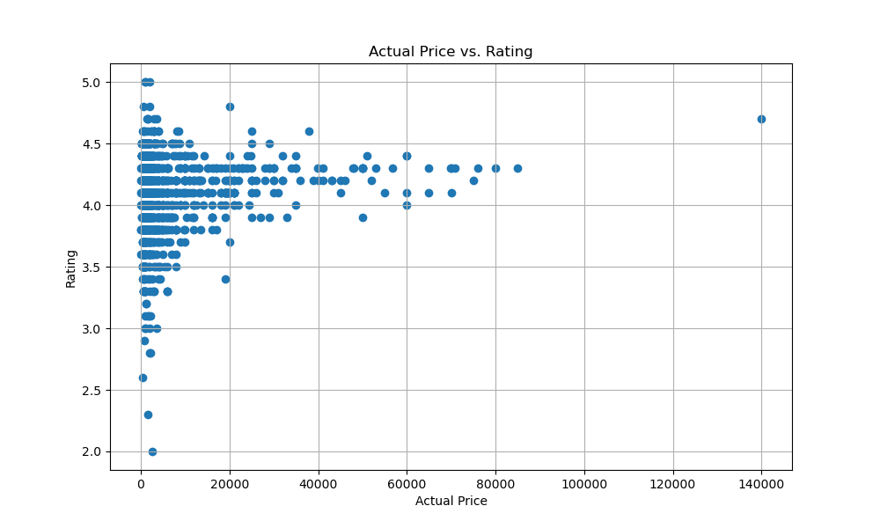
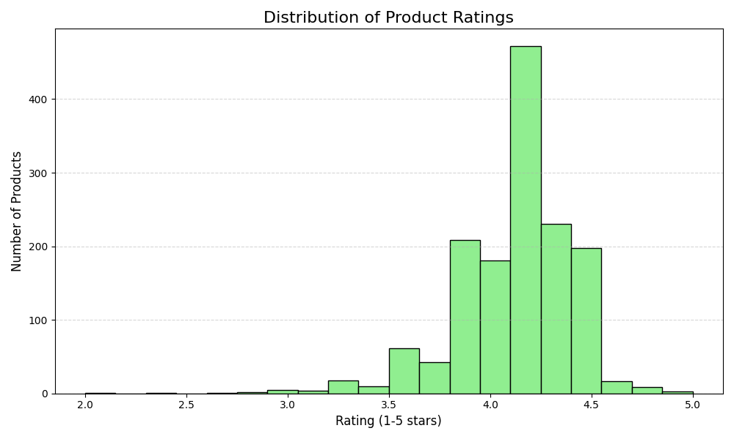
3. Pricing and Customer Satisfaction
There is no strong relationship between higher prices and higher ratings.
Many expensive items (above 50k) average around 4.0 stars, while cheaper accessories often reach above 4.5 stars.
Overall effect is positive, with most products rated between 4.0 and 4.5.

Slide 8
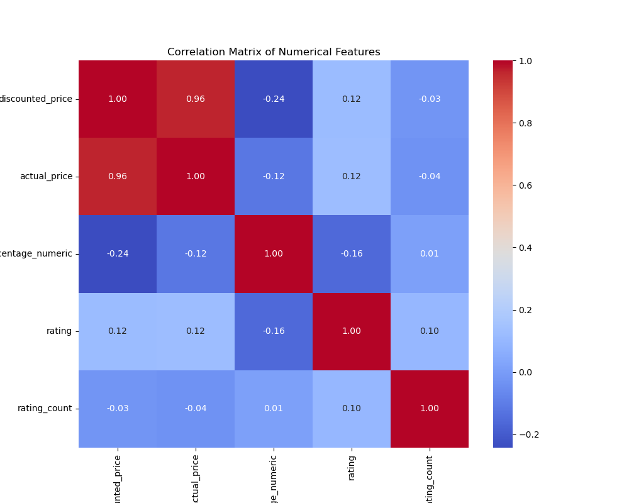
4. Correlation
Insights
A small negative correlation (-0.24) exists between discounted price and rating.
This suggests that as prices increase, customer ratings tend to decrease slightly.

Slide 9
Insights gained from data interpretation

Slide 10
1. Accessories Drive Customer Activity
Low-cost products, especially cables, play a major role in attracting customers.
They may not generate high revenue per item, but they consistently bring traffic to the store due to their volume.

Slide 11
2. Higher Prices Lead to Higher Expectations
Premium products receive more scrutinization.
When an expensive item underperforms, lower ratings reflect higher customer expectations, which aligns with the negative price-rating correlation.

Slide 12
3. Strong Overall Customer Satisfaction
Most products perform well in terms of ratings.
Any product below 3.5 stars stands out and should be investigated by inventory or quality teams.

Slide 13
Recommendations

Slide 14
1. Increase the quantity of high-demand accessories
Maintain strong stock levels for USB and HDMI cables.
These items have high turnover and contribute significantly to customer engagement.

Slide 15
2. Increase quality checks for premium products
For products priced above ₹20,000, introduce more thorough quality control.
These customers expect reliability, and negative reviews tend to be more severe on revenue.

Slide 16
3. Apply strategic pricing
Since higher prices are linked to slightly lower ratings, avoid aggressive price increases for mid-range electronics.
Competitive pricing or moderate discounts can help preserve customer satisfaction.

